Slide 1
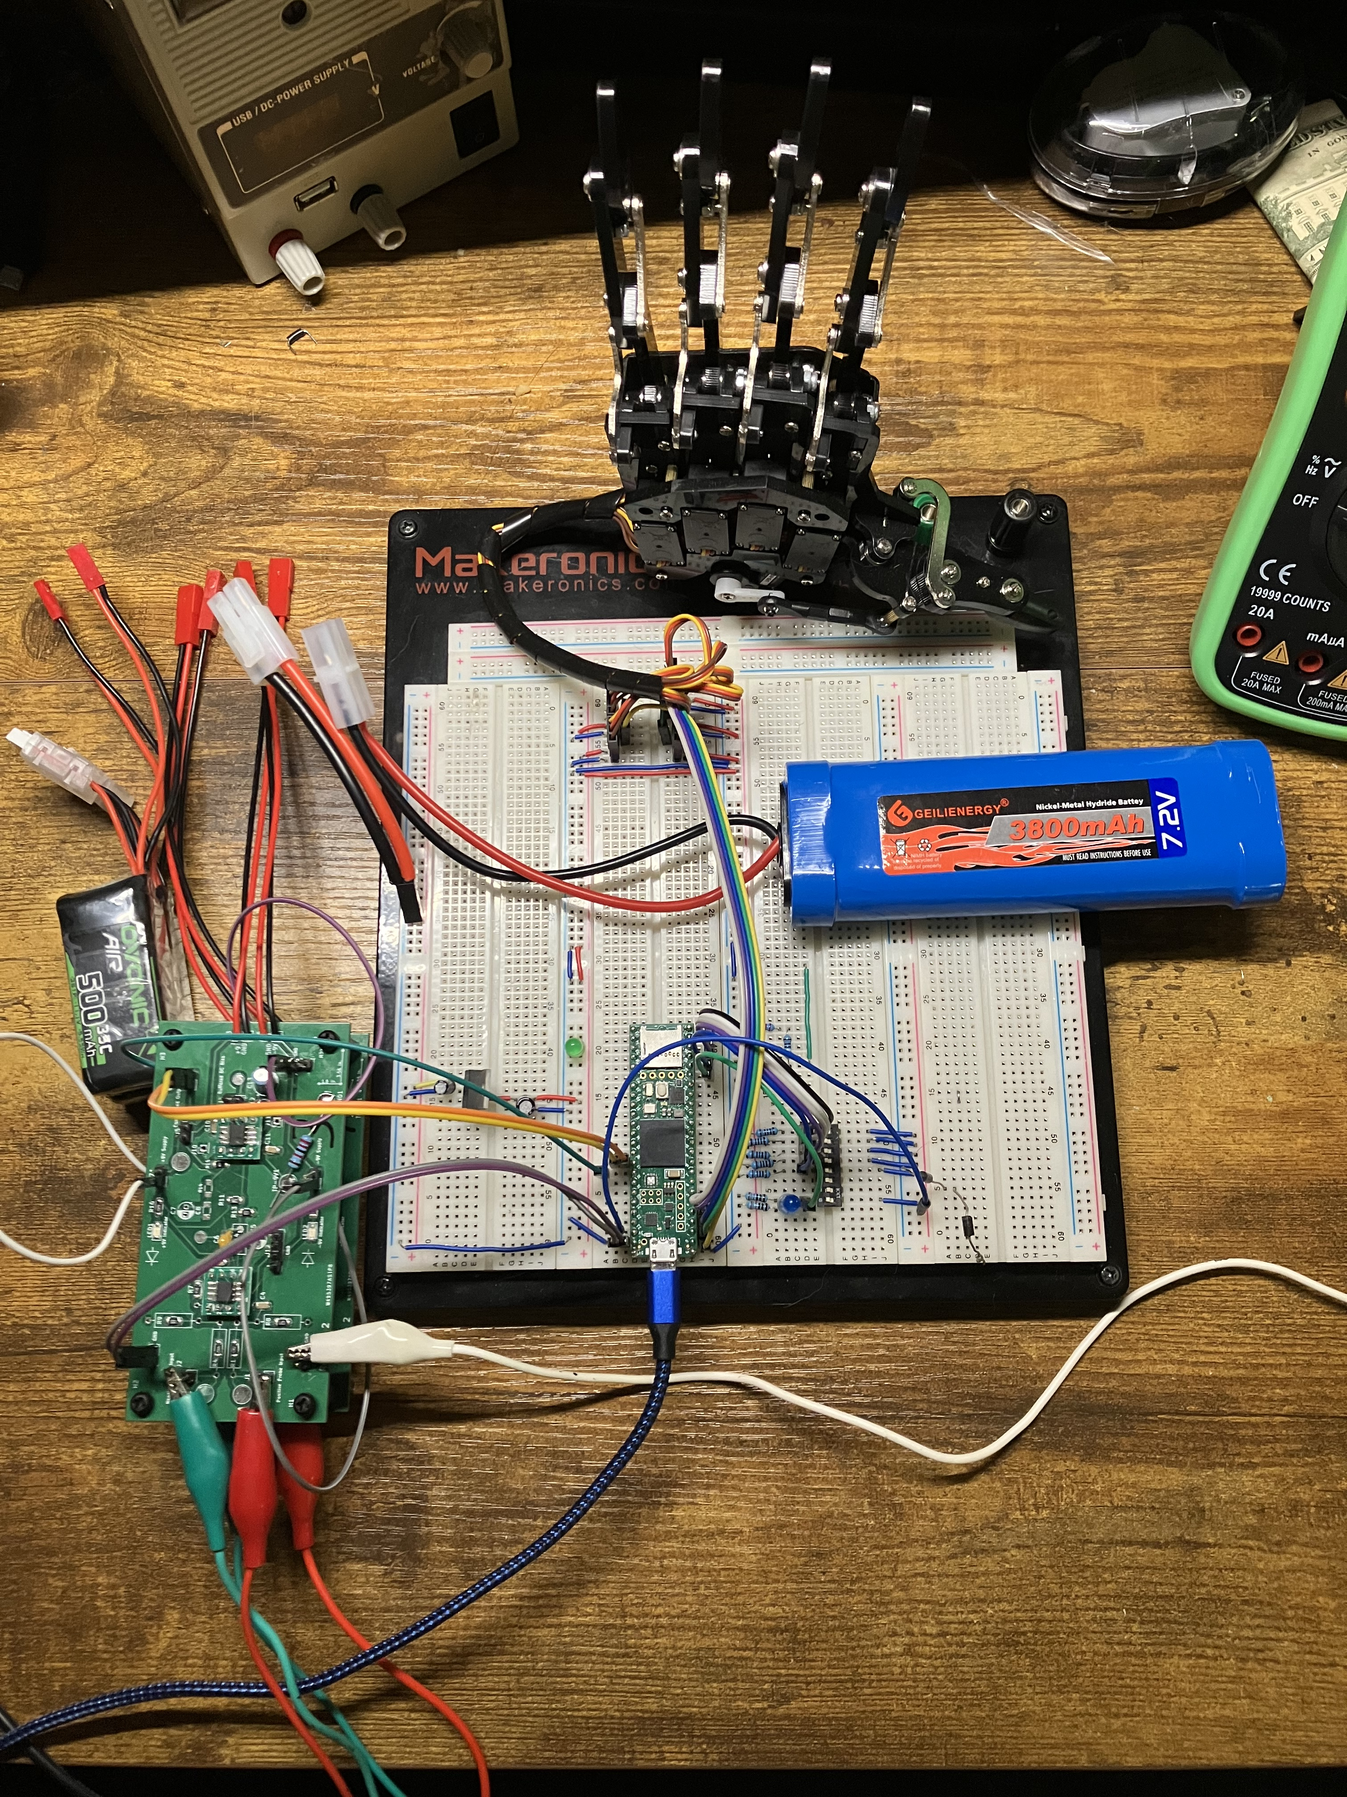
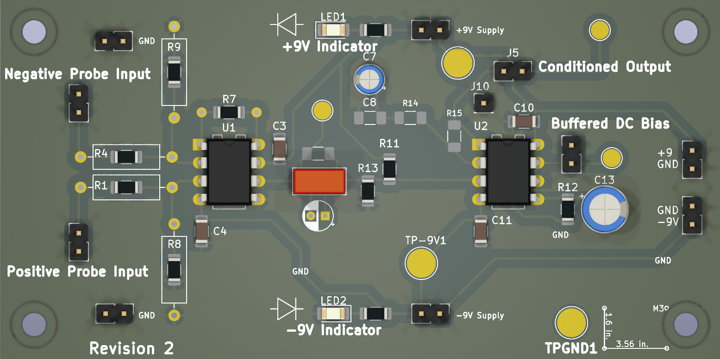
Motorized Robotic Hand Controlled Hand by Surface Electromyography (sEMG)
Authors: Jay E. Bernstein, David J. Mora, Juan R. Ortiz; Advised by Dr. Norali Pernalete
Block Diagram
Abstract
The objective of this project was to discover the fundamentals of signal acquisition and processing, in a situation requiring extremely precise hardware requirements in order to achieve both common mode signal rejection and extremely high gain. Because this is a medical device, considerations of safety had to be made as well. The final product is a printed circuit board designed around the Texas Instruments INA82x that handles differential gain, with input resistance to limit the shock hazard were a fault to occur. The amplified input signal is processed so that a microcontroller is able to determine what command the signal is closest to.
MCU (Teensy 4.1)
Amplifier
Capture 1000 Samples at 40kHz with ADC
Protected Inputs to Instrumentation Amplifier IC
Surface EMG Pads
Normalize, Rectify, and Amplify ADC Input
Robotic Hand
AC Coupled and Buffered Output
Illustration of Finger Detection/Thresholding
Finger Detection Algorithm
Software/Hardware Overview
The hardware is an instrumentation amplifier IC configured for a gain of approximately 2000 The hardware of our amplifier circuit is utilizing two instrumentation amplifiers being an INA823 and INA828. Our amplifier circuit was modified to have a gain of approximately 2000 with incorperated saftey components such as input resistors to limit shock hazard. The microcontroller of our choice is a Teensy 4.1 that features an ARM Cortex-M7 600MHz processor. This microcontroller was selected due to its performance and speed as a prosthetic requires both. Our software was developed using the Arduino IDE as the microcontroller was compatable. When a signal is detected using the electrodes, it then flows into our amplifier and out into our microcontroller in which we have a control system. The control system works by first detecting, normalizing, rectifying, and amplifying the signal. We then generate an arbitrary peak value using our filtered signal. This arbitrary peak acts as a peak detector in some way, but for our control system it will be used to in conjuction with a distance calculation to activate threshold to control the hand. The individual fingers on our hand are stored in an array, but we are also utilizing a 3x5 array to store the current and previous position of each finger as well as an enable value. Our software was modified to accomadate for two different probes that would allow us to easily differentiate thresholds between fingers. Once a threshold is met or detected, the respective finger/s will be enabled and allowed to move to its specified position. If more than one condition is met, our software allows for multiple movements. Once a condition is no longer met it reverts back to its initial state and waits for the user. An aditional feature that was implemented was a debug mode in order to acess that each finger functions properly in the case something goes wrong.
﻿
Block Diagram showing the acquisition and processing chain for the EMG signals. Muscle activations are sent into the amplifier, which is conditioned so that the onboard ADC of the Teensy can acquire it properly. A 40kHz periodic sample is taken, processed slightly, and used to make a decision on the activation of the robotic hand
Recorded Vs Processed Signal From Probe
Clench
Sensor 2 Processed Amplitude
Ring
Index
Measured Point
Middle
Thumb
Pinky
Gain Comparison of Probe Board Revisions
Open Hand
Sensor 1 Processed Amplitude
A render of the revision 2 amplifier PCB, altered from the manufactured version for clarity. Large silkscreen text is used to emphasize the regions of the board and their operation
Table 1 (top) displays the output of the amplifier in blue, and the processed signal in orange. The rectification is the most prominent component, but digital filtering and gain also occur. Table 2 (bottom) displays the difference in frequency response of the two revisions. The differences in high frequency performance is mostly correlated to a change in IC, from the INA823 to the INA828
Conclusion
Compare amplifier characteristics between discrete inamp, breadboarded ina129, and assembled hardware. Design tradeoffs made, such as removing 60hz HP filter. Nature of MUAPs, long spacing and frequency components. Power supply noise rejection and grounding issues with amplifier. Conclude with what went right what went wrong, what to improve next time
References
Michael Haidar, Jason Hwang, and Srikrishnaa Vadivel, “EMG Robotic Hand,” Cornell University, 2016. Accessed: Apr. 21, 2024. [Online]. Available: https://people.ece.cornell.edu/land/courses/ece4760/FinalProjects/f2016/mh2298_jyh37_sv376/mh2298_jyh37_sv376/mh2298_jyh37_sv376/index.html
6mm 8mm 10mm 20mm 30mm. 32Point = 0.5 inch High

Slide 2
Clench
Open
Sensor 2 Processed Amplitude
Ring
Index
Measured Point
Middle
Open
Thumb
Pinky
Open Hand
Sensor 1 Processed Amplitude

